Slide 1
TIN MODEL

Slide 2
Objectives of this session
1
Introduction to TIN MODEL
What is a TIN MODEL
Delaunay Triangles
2
Making a TIN MODEL
Understanding TIN MAX SIDE
3
Exporting Contours
Methods to improve contours
Sorting data to improve contours
4
Exporting Data for CSV
Using a planned line to slice data
Notes:
Stressed Water Supply
Issue
Maintain the health of traditional water sources and execute a water source diversification strategy
Solution
Xylem’s leading-edge technologies monitor, pump and treat water from all sources and enable water reuse
Aging Infrastructure
Issue
Utilities have to effectively assess and identify high-risk areas for repair/replacement before problems occur
Solution
Xylem’s intelligent pipeline and critical infrastructure services perform condition assessment, identify defective assets, provide bypass services and replacement technologies, reduce or eliminate combined sewer overflows and leaks/non-revenue water
Stormwater & Flooding
Issue
Significant increase in severe weather patterns is causing flooding and related damages to communities
Solution
Xylem’s flood management solutions include sensors for early warnings, dewatering for disaster response, communications for recovery and submersible pumping for resilient infrastructure
Regulatory Compliance
Issue
Utilities must successfully comply with a growing body of compliance regulations
Solution
Xylem’s analytics and sensors evaluate a broad range of water quality parameters, and our technologies treat water and wastewater to meet regulatory standards
Non-Revenue Water
Issue
Utilities have an important opportunity to reduce persistent and costly water losses from leaks and faulty meter readings
Solution
Xylem’s broad portfolio of solutions monitors for, and identifies, water leaks, as well as faulty meters. Our communications network enables point-to-multipoint communications throughout the system
Operating Strategy Reducing Costs
Issue
Utilities want to lower operating and energy costs, and leverage new revenue opportunities
Solution
Xylem offers industry-leading pumping and treatment solutions for energy efficiency, and software-enabled solutions to optimize operations and identify revenue opportunities

Slide 3
What is a TIN MODEL?
TIN = Triangulated Irregular Network:
Connect three soundings to make a triangular ‘face’. The faces can then be used to represent a surface.
The TIN MODEL program in HYPACK® can make models from:
XYZ Data files.
Edited LOG files.
Matrix (MTX) files.
HS2 & HS2x Files
33.7
35.2
32.4
30.8
31.5
32.5
27.2
16.5
22.6

Slide 4
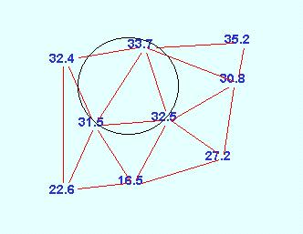
Delaunay Triangles
The TIN MODEL program normally makes Delaunay triangles.
Delaunay Triangles:
If you draw a circle that contains all three points of any triangle, no other point will be contained in the circle.
Takes longer to generate a model.
Reportedly ‘more accurate’.
Not always desired…
Disable if you run single beam lines non-perpendicular to side slopes.
To disable, click the ‘Align TIN with LNW (Single Beam Data).
You will need to provide a LNW file
Note: If you have single beam data run non-parallel up a side slope, you may want to disable the creation of Delaunay triangles.

Slide 5
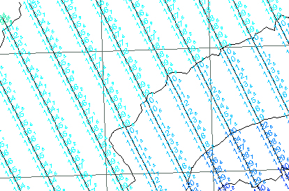
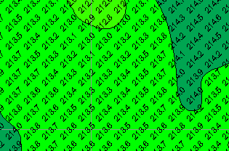
TIN MODEL: Data Export
Output:
Edited ALL Files Along Planned Lines
XYZ at regular intervals.
XYZ Differences at regular intervals.
XYZ Differences at TIN MODEL vertices.
BAG (Bathymetric Attributed Grid) Surfaces

Slide 6
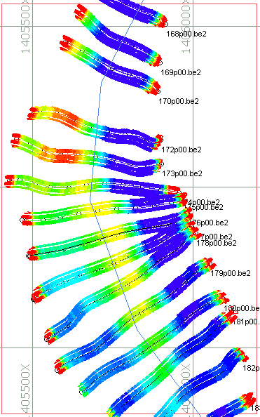
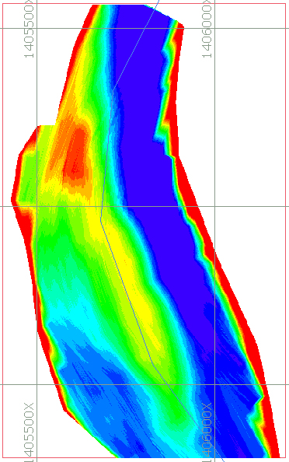
TIN MODEL: Filled MTXs

Slide 7
Making a TIN MODEL

Slide 8
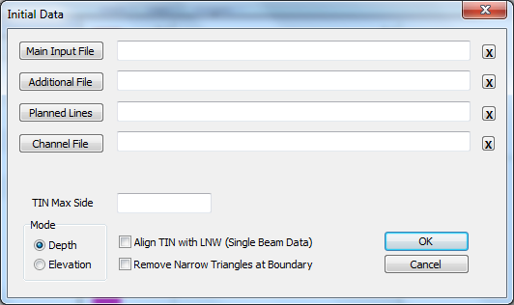
Making a TIN Model
Clears the Text Entry
Primary Data Files
(Earlier file if reading more than one.)
Second Data Files
(Later file if reading more than one.)
LNW File for Volumes or Export Along Line
CHN File for Volumes
Maximum connection distance between data points.
Create Non-Delaunay Triangles
Mode inherited from GEODETIC PARAMETERS
Eliminate edge triangles with a vertex less than 1º.
Note: You can enter multiple files as your ‘Input File’.

Slide 9
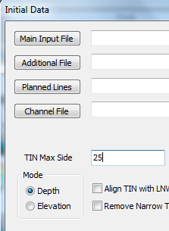
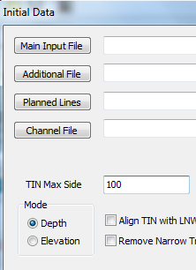
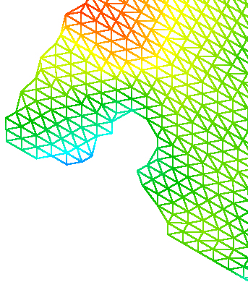
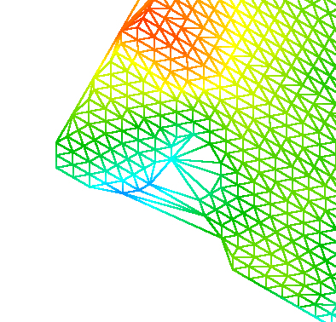
TIN Max Side
General rule of thumb, use 150% of your line spacing or cell size when making a TIN MODEL
TIN MAX SIDE = 25
TIN MAX SIDE = 100

Slide 10
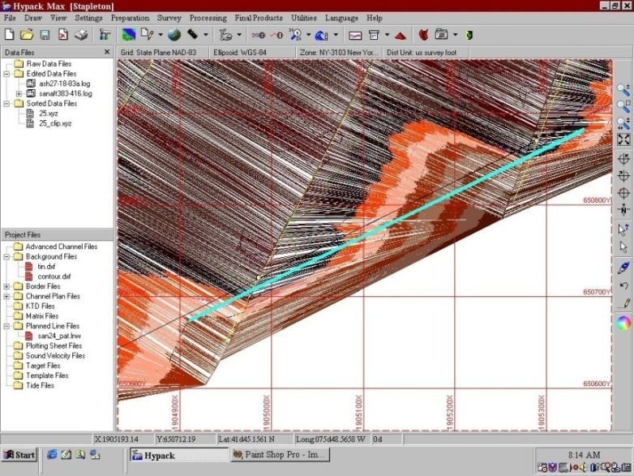
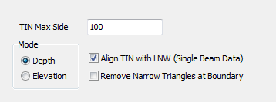
Align TIN with LNW
‘Scalloping’ of Single Beam Data in TIN MODEL.
Use when single beam survey lines are not perpendicular
to bottom contour.
Eliminates artificial ‘scalloping’ of bottom.

Slide 11
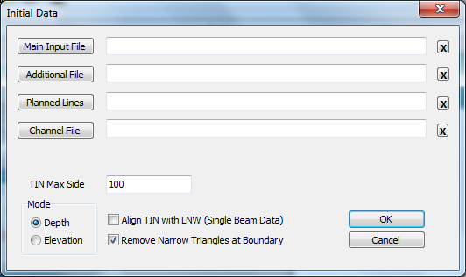
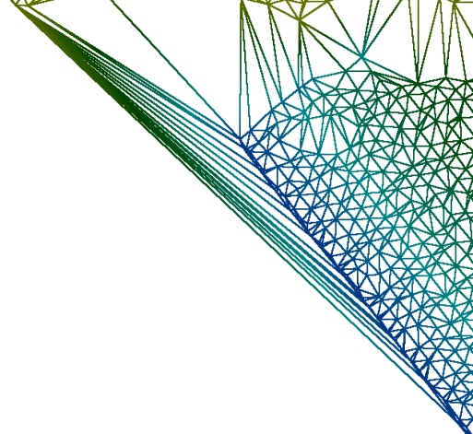
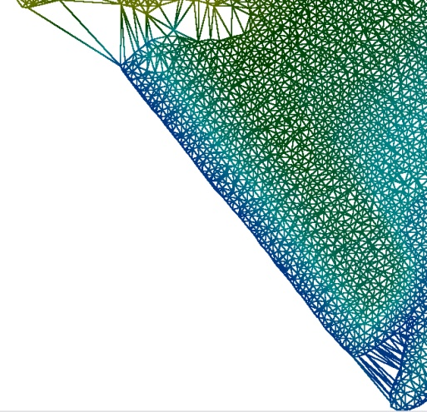
Removing Narrow Triangles
Without Removal
With Removal
Works its way from the outside of the TIN MODEL inwards, eliminating triangles with a vertex of < 1˚

Slide 12
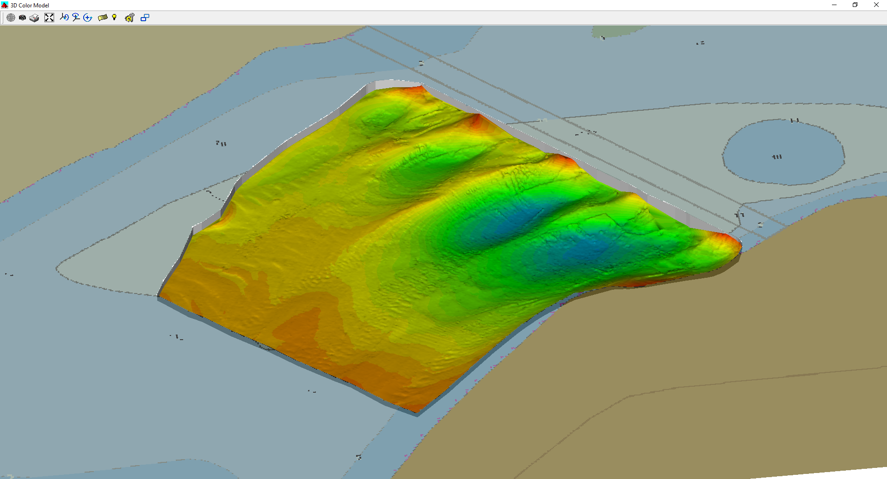
Sample TIN MODEL

Slide 13
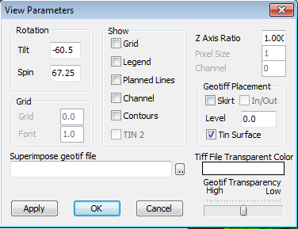
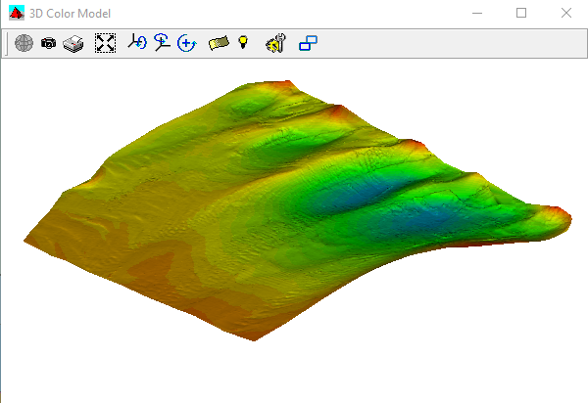
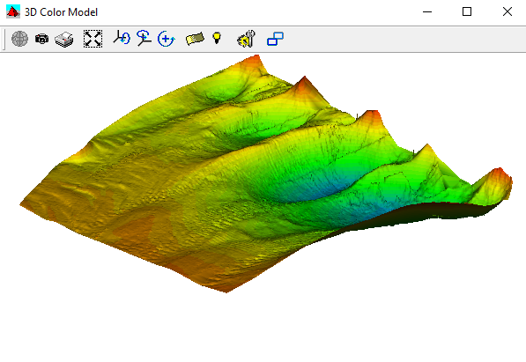
Vertical Exaggerations
1x
3x

Slide 14
Exporting from TIN MODEL

Slide 15
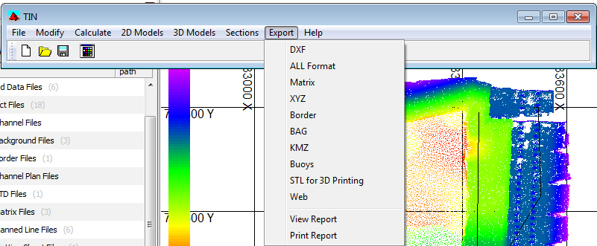
TIN MODEL: Export
The EXPORT menu provides access to all formats for export

Slide 16
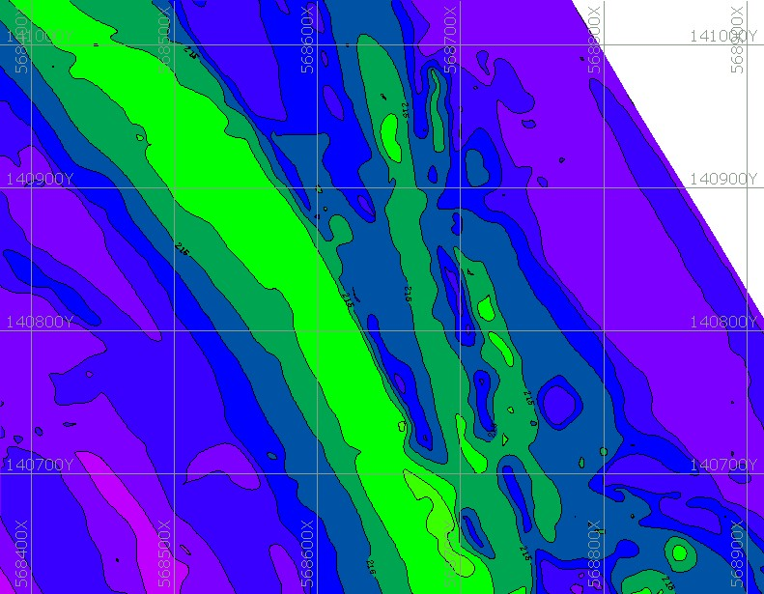
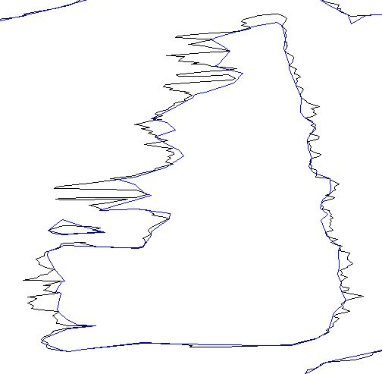
Improving Your Contours: Use Sorted Data
TIN from Edited Data
For the best results, we recommend you contour your Sorted data.
The contours will be smoother.
TIN from Sorted Data
Contours of Edited All Format Data (Black) vs. Sorted Data (Blue)

Slide 17
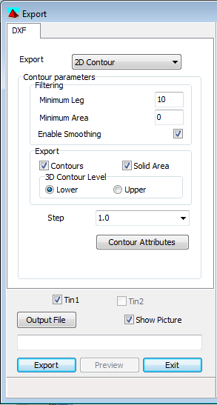
DXF Contour Options
Contours:
Exports contour polylines with labels.
Labeling, line weights and styles are defined in Contour Attributes.
Step: Contour Intervals
Fixed increment (e.g. Every 1m)
Color Scheme
Custom (enter contour levels)
File (read levels from file).
You have to examine the contour attributes before you can output your contours.

Slide 18
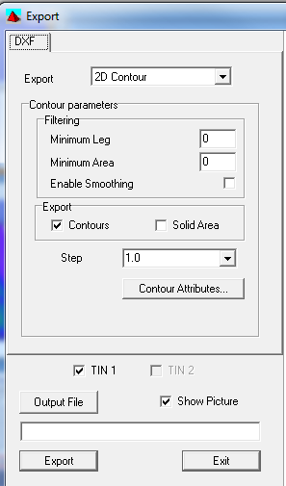
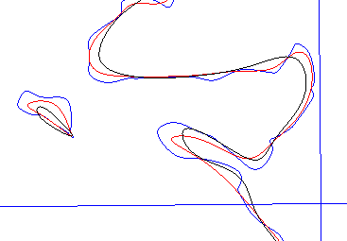
Improving Your Contours: Minimum Leg
Beware! | If you set the Minimum Leg large enough, it can move a contour to the wrong side of a sounding!

Slide 19
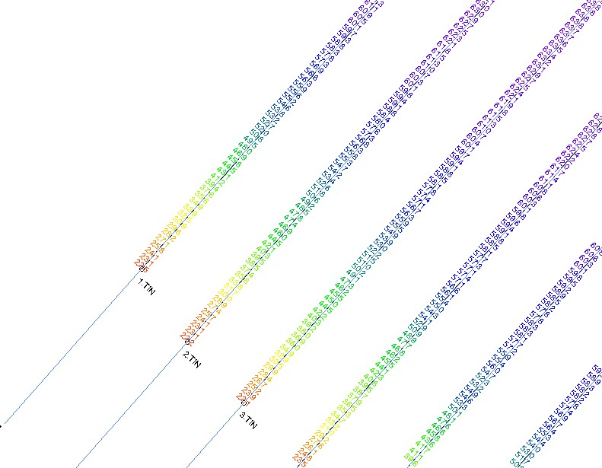
Export Data Along Planned Lines
TIN MODEL determines the z-value of the surface at exact increments along the planned line.
Data is exported to Edited ALL format.
One file for each line.
One LOG file with the names of all data files.
Template data of the planned line is embedded in the header of the output data files.
The perfect input to CROSS SECTIONS AND VOLUMES!

Slide 20
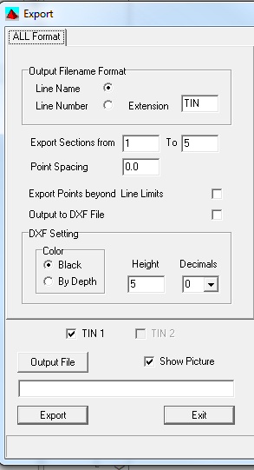
Exporting Data Along a Planned Line
Input:
XYZ, LOG or MTX File for TIN Surface
LNW file to define sections
LNW file can contain multiple segment lines
You can extend export beyond the ends of the planned line

Slide 21
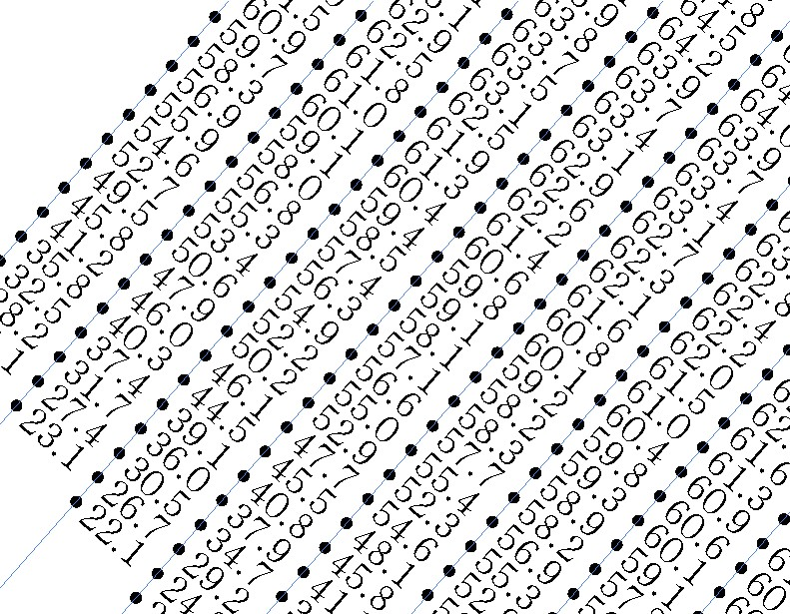
Exporting Along a Planned Line: DXF Format
Same as exporting along a planned line, except it writes info to a DXF file.

Slide 22
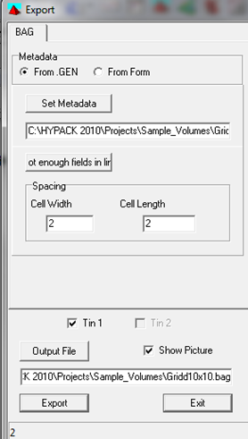
BAG File: (Bathymetry Attributed Grid)
Read attribute data from existing BAG, HYPACK Metadata or XML Metadata file
Edit the Metadata file
A BAG file contains gridded XYZ data with attribute data.
Set the grid spacing
Give your BAG file a name (*.bag)
Export

Slide 23
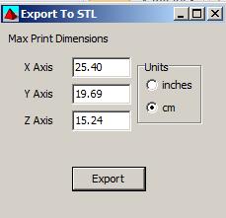
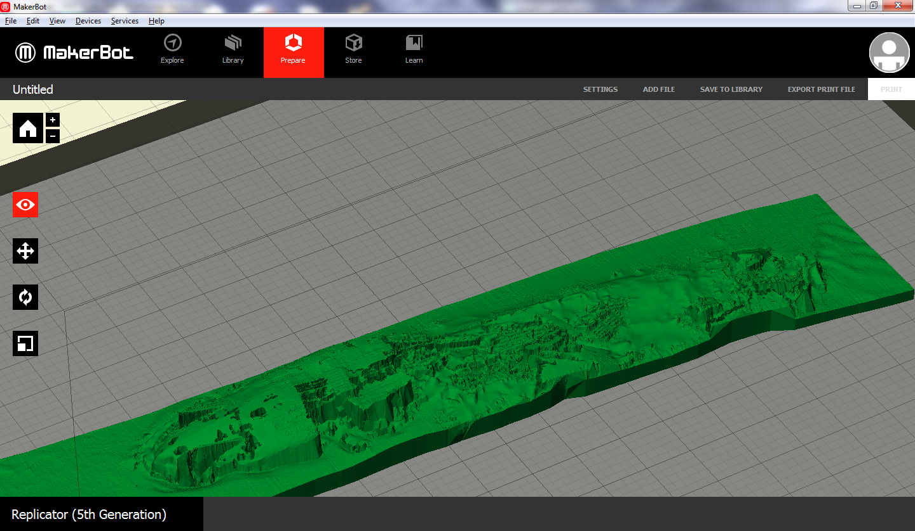
Export for 3-D Printing
Most 3-D printing programs can import STL format files.
Export to STL requires the maximum print dimensions. These are based on your 3-D printer’s capabilities.
The dimensions default to a MakerBot Replicator 5th Gen 3-D Printer.
This is what the STL file looks like (wreck) after importing it into the MakerBot printing control program.

